Slide 1
Conditional sentences

Slide 2
Types of Conditional sentence
Type | Use | Formula | Example
Zero Conditional | General truths or facts | If + simple present- Simple present | If you heat ice, it melts.
First conditional | Real possibilities in future | If + simple present- will+ verb1 | If it rains, I will stay home.
Second Conditional | Unreal hypothetical situations | If + simple past- would+ verb1 | If I won lottery, I would travel all around the world.
Third Conditional | Unreal past hypothetical situation | If + Past perfect- would have + Verb3 | If I had studied hard, I would have passed the exam.

Slide 3
Real conditionals: Present and Future

Slide 4
Present real conditional
Used to talk about general truths, habits and things that happen again and again
Formed by using the simple present in both if clause and the result clause

Slide 5
Example
If you walk in wearing jeans and a T-shirt, you are not likely to get the position.
If you disagree too much in your first conversation, the other person may think you are just too different.

Slide 6
Future real conditional
Used to talk about what will happen under certain conditions.
The result clause give result.
Formed by using simple present in if clause and the future with will or going to in the result clause.

Slide 7
Example
If you smile frequently, it will make other people comfortable.
If you stay honest and professional, you will get closer to the job you want.

Slide 8
Use of when or whenever
When or whenever can be used instead of if for both the present and future real conditional.

Slide 9
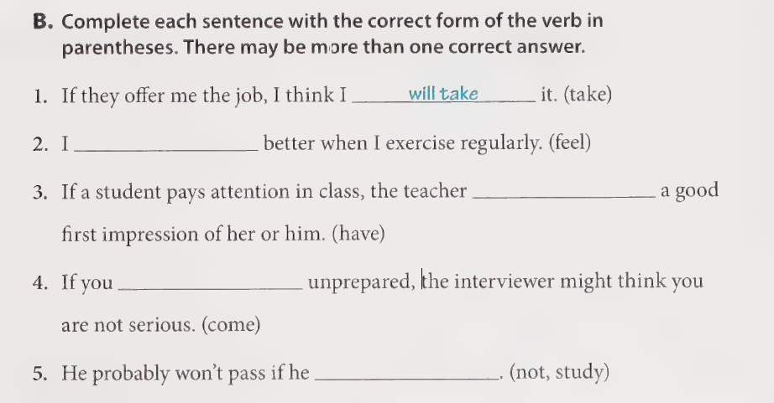
Exercise

Slide 10
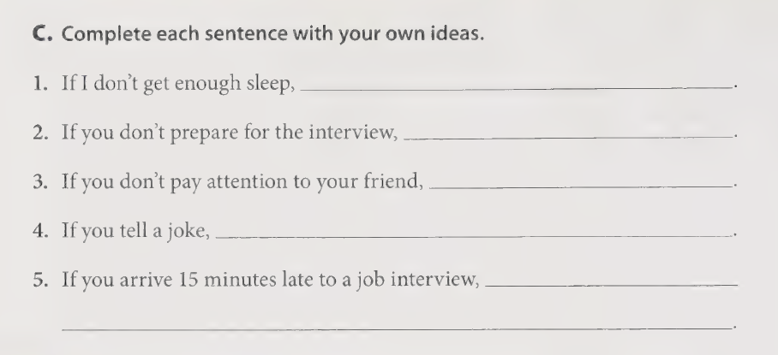

Slide 11
Quiz
1. What would you do if it ________ on your wedding day?
rained
will rain
would rain
2. If she comes, I _____ call you.
will
would
would have
3. If I eat peanut butter, I ________ sick.
would have gotten
would get
get
4. What will you do if you ________ the history exam?
would fail
will fail
fail
5. If they had not _____ the car, I would have driven you.
take
taken
would take

Slide 12
Quiz
6. If it snows, ________ still drive to the coast?
will you
would you
would you have
7. "He would have gone with you if you had asked him." Which conditional is this?
first
second
third
8. "If I won a million dollars, I would buy my own airplane." Which conditional is this?
zero
first
second
9. "If I forget her birthday, Andrea gets upset." Which conditional is this?
zero
first
second
10. "What will she do if she misses the bus?" Which conditional is this?
first
second
third

